Slide 1
Stock Predictions
vs
Actual Price
Group 1 : August 6th 2024
William Aromando
Dan Becker
Vivan Rajagopalan
Anthony Nguyễn

Slide 2
Project Intro
Searching for data
Searched on Kaggle for datasets to work with, we knew we wanted to work in stocks or finances. (https://www.kaggle.com/)
Created a repository and added each member as a collaborator
Found Google stock and Apple stock data on kaggle and imported it into our repo to review the data
Decided to pull predictions from the Google and Apple datasets
Filtered the data to exclude already known data to complete predictions on
Compared prediction data to the known data to visualize prediction accuracy

Slide 3
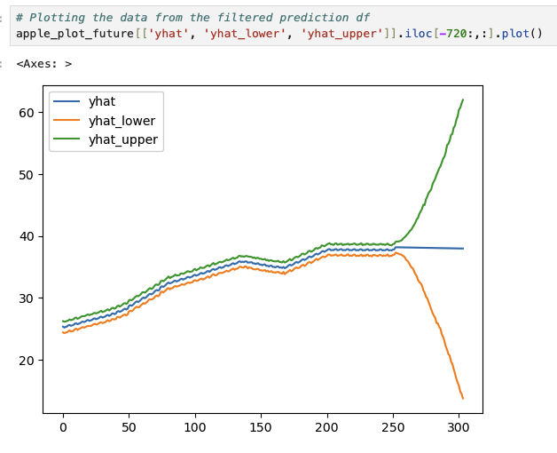
Apple Stock Predictions
2016 - 2017 year data
import Apple_stock_history.csv
Checked/cleaned the data
filtered data to necessary columns
Placed filtered data frame into a Prophet model for predictions
Plotted predictions

Slide 4
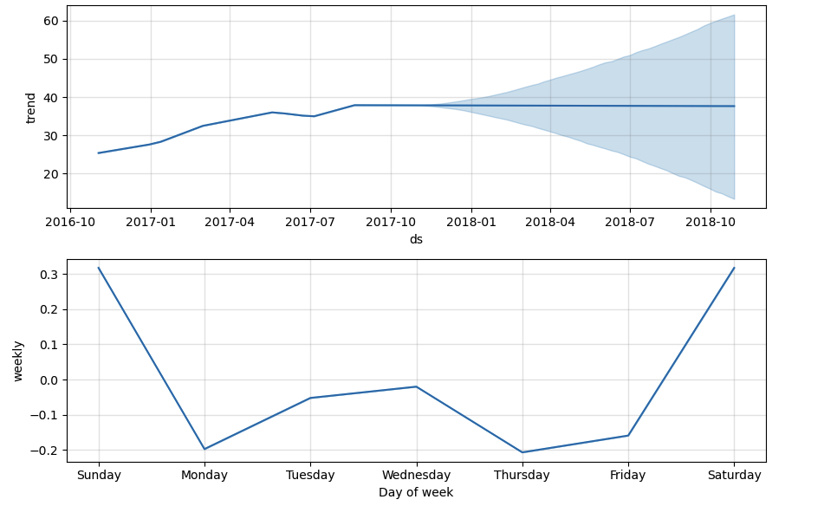
Plotted data in different format by year and day of week for possible trend spotting

Slide 5
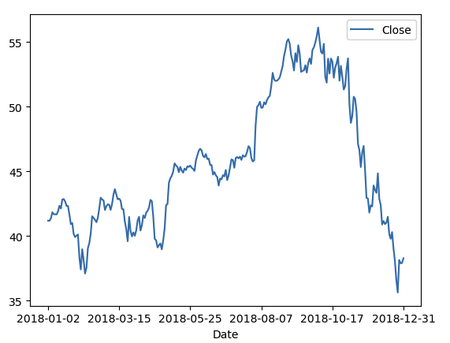
Actual Apple Stock
Filtered 2018 Data
Filtered the original data frame to only the year 2018 for actual stock prices
Prepared this data to be compared to the predicted data for 2018

Slide 6
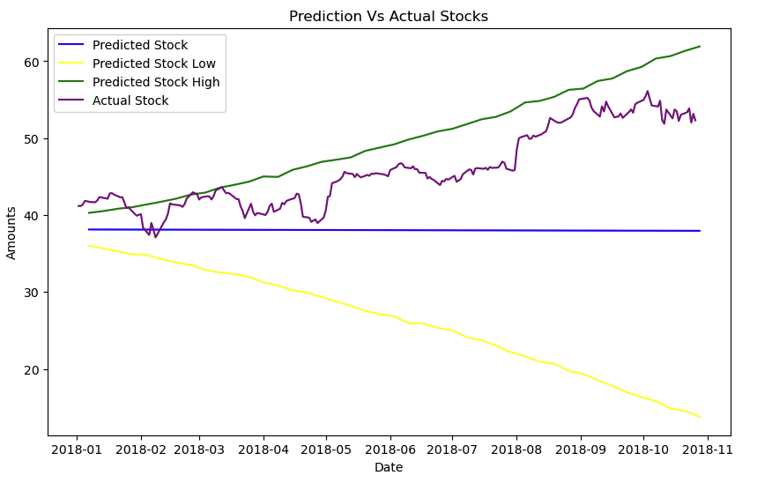
Actual vs Prediction
Apple Prediction accuracy
Plotted the Apple stock predictions and the actual stock price from 2018
Our figure showed that in this instance the prediction model was accurate

Slide 7

Google Stock Predictions
2016 - 2017 Data

Slide 8
Actual Google Stock

Slide 9
Actual vs Predicted
Google prediction accuracy

Slide 10
Project Recap
Checking the accuracy of Prophet Analysis

